Slide 1
Turning point:
“Baby-boom" generation retires
Young incorporation to labour market disminises
 | 2010 | 2020 | 2030 | 2040 | 2050 | 2060 | % Variation 2008-60
EU 27 Population (>65) Milions | 86.8 | 103.1 | 122.5 | 139.6 | 148.4 | 151.5 | 79%
Very old population (>80) Millions | 23.3 | 29.3 | 36.0 | 46.1 | 56.6 | 61.4 | 181.1%
Market force (15-65) Milions | 336 | 330.3 | 321.6 | 309.5 | 298.4 | 290.4 | -13.6%

Slide 2
Active ageing means remain participating in the labour force, develop other non monetary productive activities and to live healthy and independently. (WHO, 2002)
Investing in persons to reinforce their
competences and abilities.
Older people unexplored
potential

Slide 3
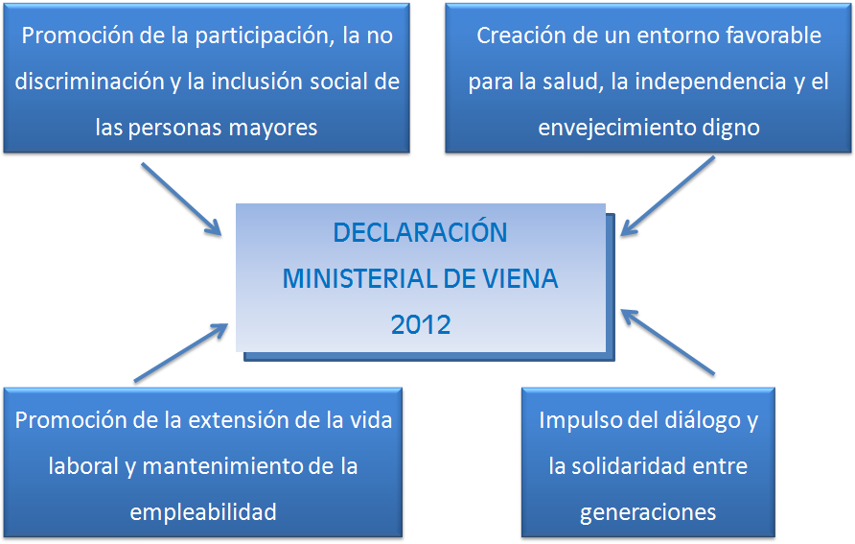

Slide 4
